Slide 1

Housing Sales Price Prediction
Submitted By:- Haindavi Chakravarthi
Internship:- 23

Slide 2
Table of Contents:
Introduction
Business Goal
Analytical Problem Framing
Data Analysis
Exploratory Data Analysis(EDA)
Using the Machine learning models
Conclusion
Limitations of this work and Scope for the Future work

Slide 3
INTRODUCTION:
Houses are one of the necessary need of each and every person around the globe and therefore housing and real estate market is one of the markets which is one of the major contributors in the world’s economy. It is a very large market and there are various companies working in the domain.
A US-based housing company named Surprise Housing has decided to enter the Australian market. The company uses data analytics to purchase houses at a price below their actual values and flip them at a higher price. For the same purpose, the company has collected a data set from the sale of houses in Australia.
The company is looking at prospective properties to buy houses to enter the market. You are required to build a model using Machine Learning in order to predict the actual value of the prospective properties and decide whether to invest in them or not. For this company wants to know:
Which variables are important to predict the price of variable?
How do these variables describe the price of the house?

Slide 4
Business Goal:
You are required to model the price of houses with the available independent variables. This model will then be used by the management to understand how exactly the prices vary with the variables. They can accordingly manipulate the strategy of the firm and concentrate on areas that will yield high returns. Further, the model will be a good way for the management to understand the pricing dynamics of a new market.

Slide 5
Analytical Problem Framing :
In this Machine Learning project, I will be predicting the sale price of the houses in Australian region using the provided dataset
The Surprise Housing company expects us to predict the sale price of the house along with the important variables which helps in prediction of the same
Further, we will also learn on how these variables describe the sale price of the house
The provided dataset consists of 1168 rows and 81 features (including train and test dataset)

Slide 6
Data Analysis :
Before we can proceed with data analysis part, there are missing data in some of the variables which needs to be handled the variables like LotFrontage, Alley, MasVnrType, MasVnrArea, BsmtQual, BsmtCond, BsmtExposure, BsmtFinType1, BsmtFinType2, FireplaceQu, GarageType, GarageYrBlt, GarageFinish, GarageQual, GarageCond, PoolQC, Fence and MiscFeature have missing data.
Firstly, I’m removing the variables that contains ‘missing data’ more than 80%.
We can clearly see that for the variables 'Alley', 'MiscFeature' and 'PoolQC', there are more than 80% data is missing, hence removing the same. Further I’m also removing ‘Id’ because it is unique for each row and will not help in the Prediction of sale price.
Further, I’m imputing all the other variables containing null values using KNN Imputer and fillna method
Using the above technique, I have successfully handled the null values in the dataset.

Slide 7
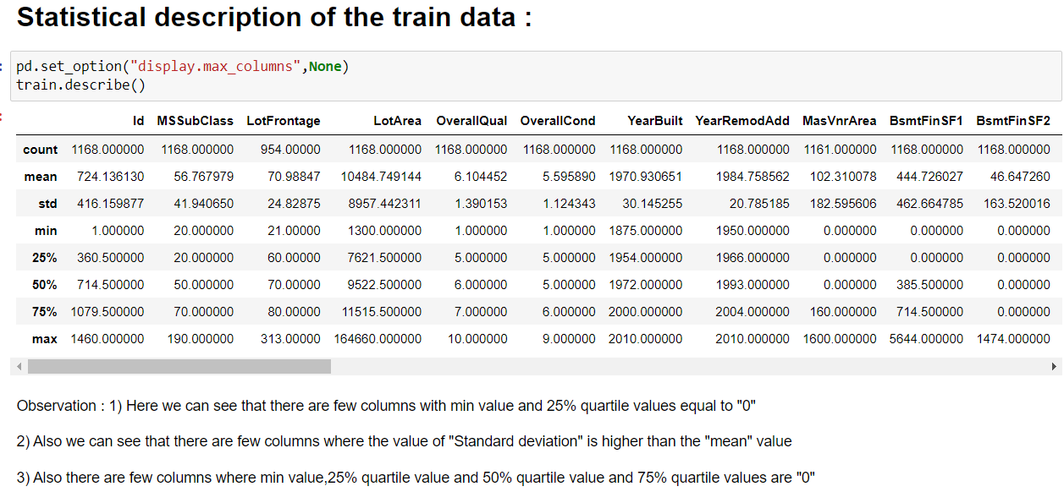
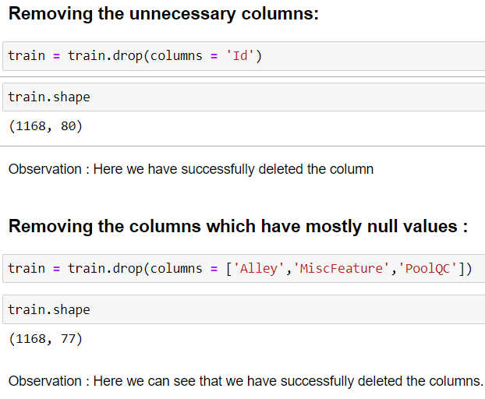
Exploratory Data Analysis (EDA):

Slide 8
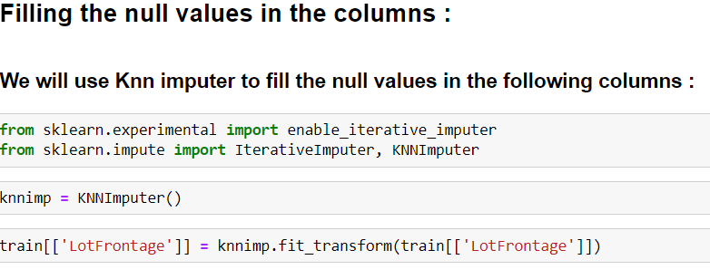
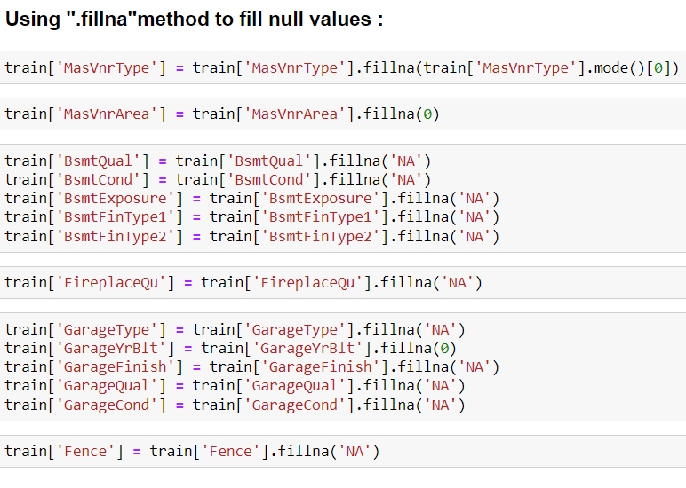

Slide 9
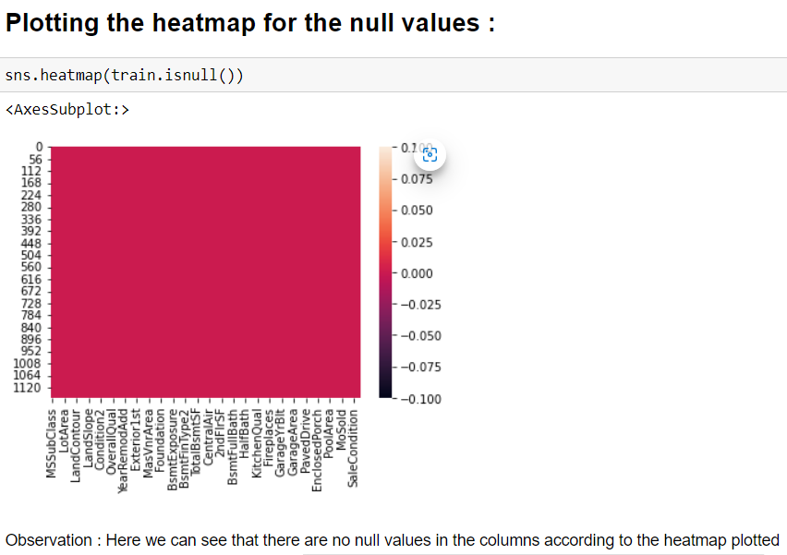
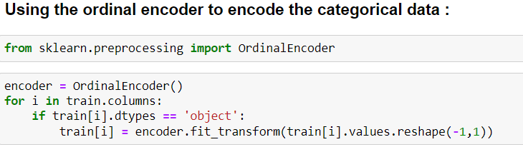

Slide 10
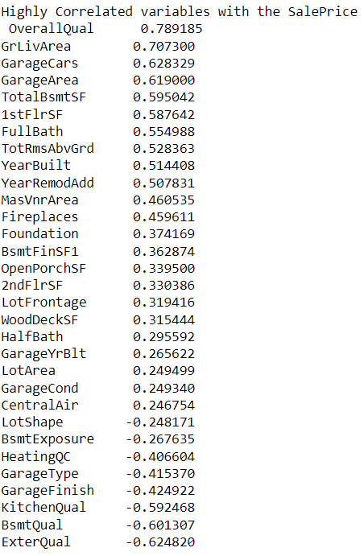
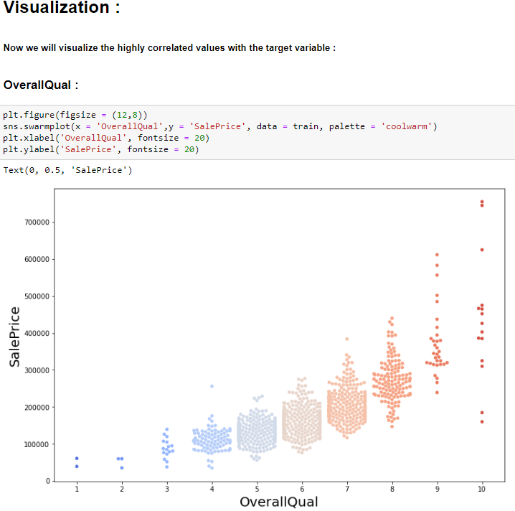
Observation : Here we have less density in the attribute 1 of the column "overallQual" at the sales price 1,00,000 and high density is from the attribute 5 to 8 .

Slide 11
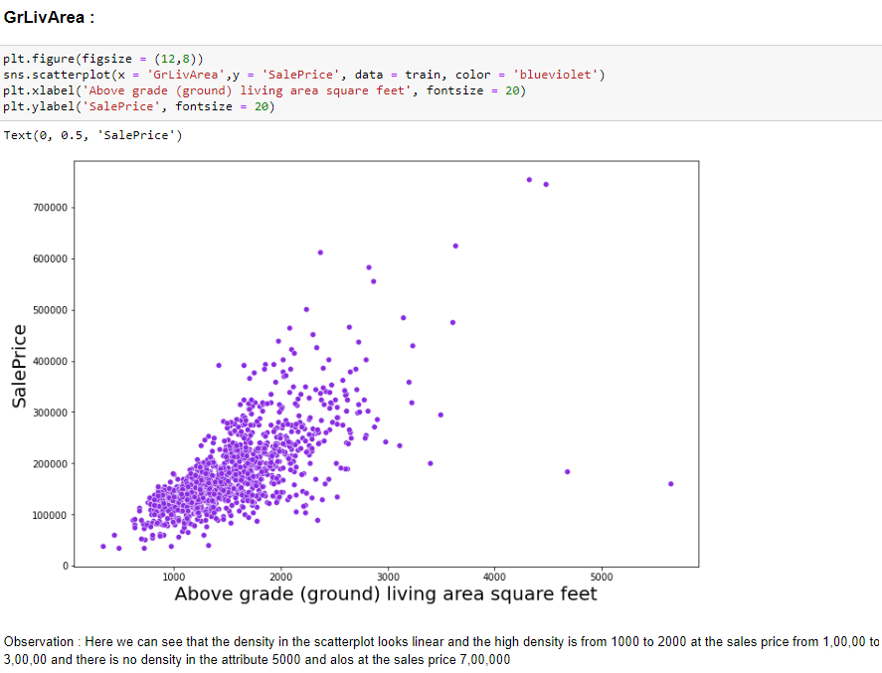
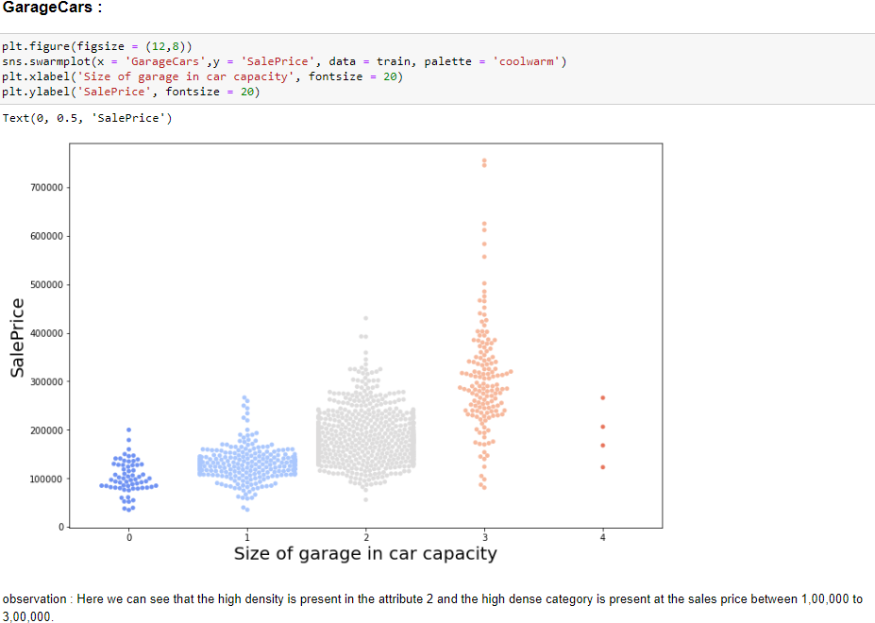

Slide 12
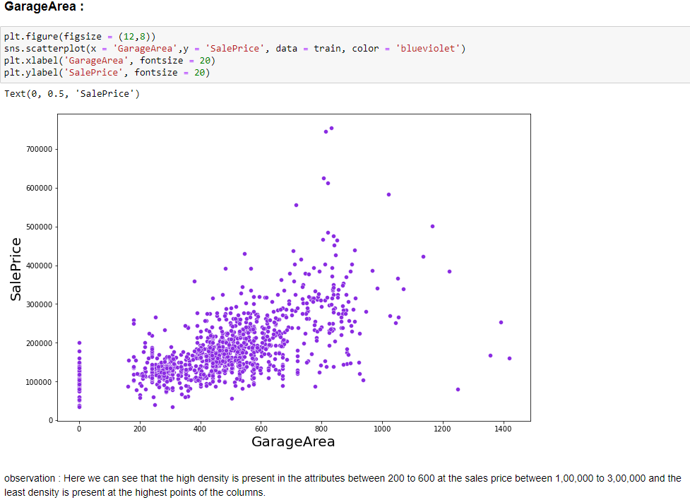
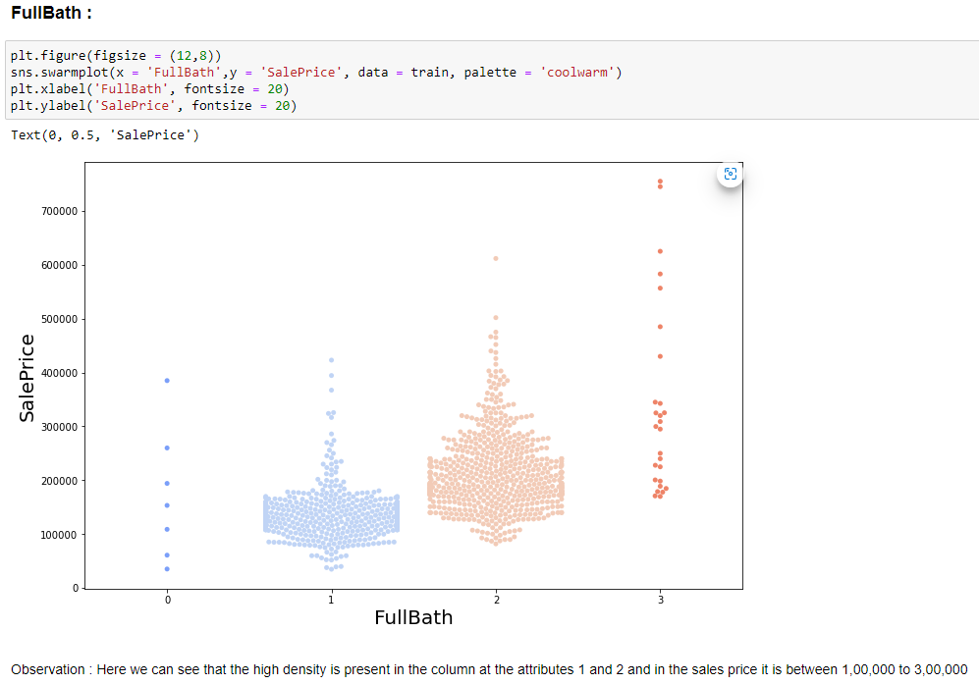

Slide 13
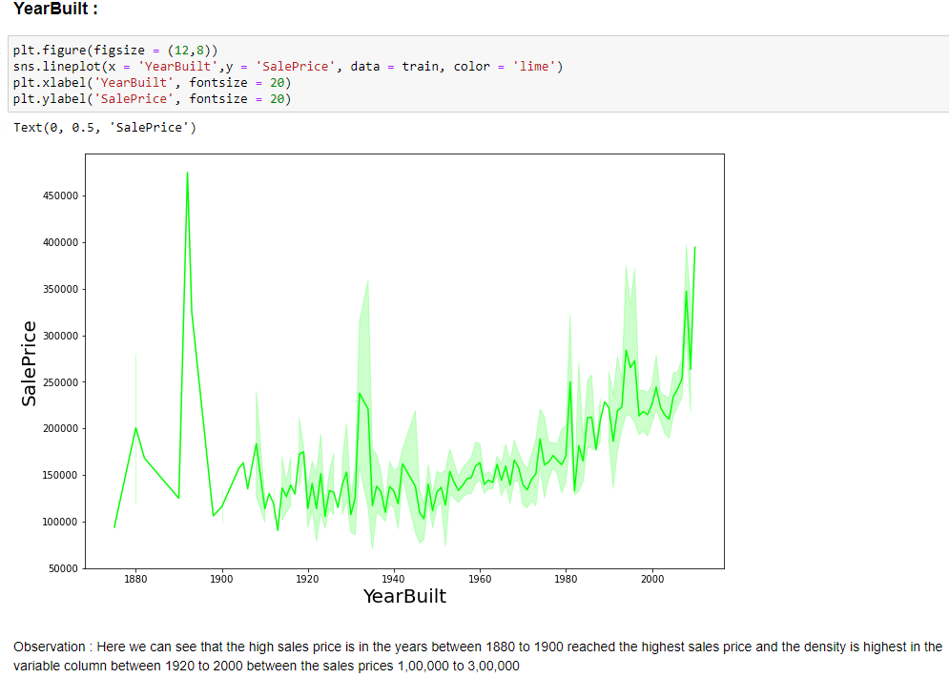
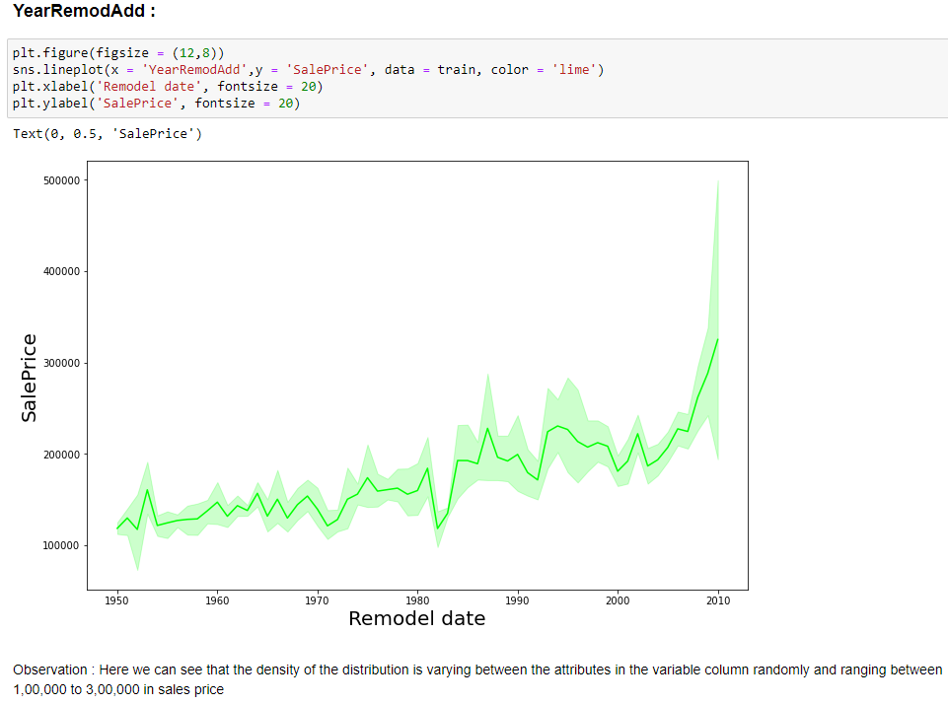

Slide 14
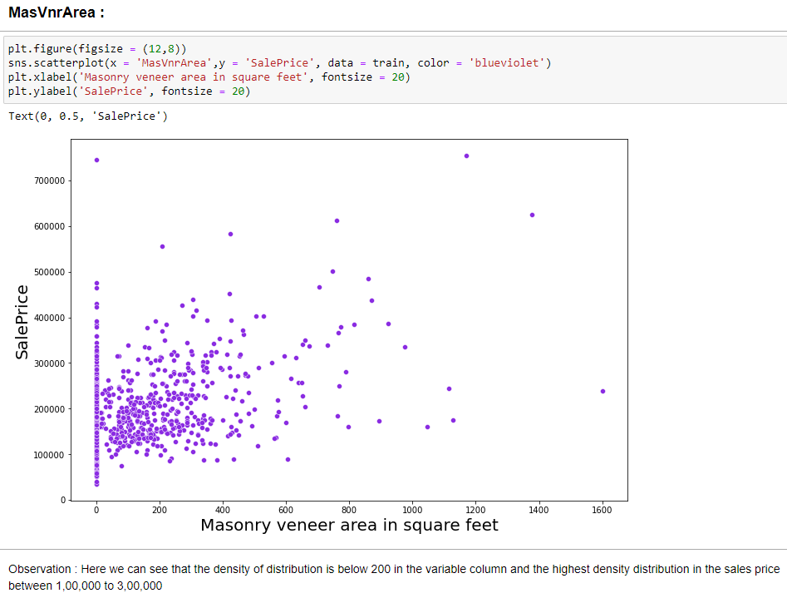
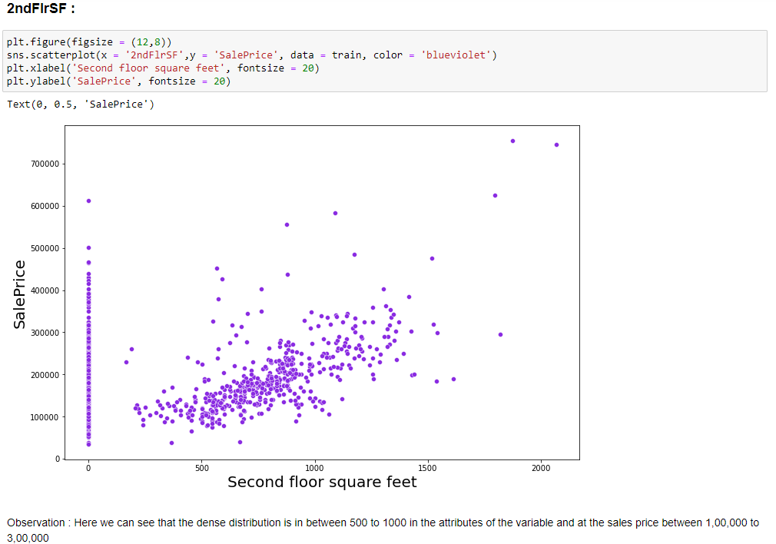

Slide 15
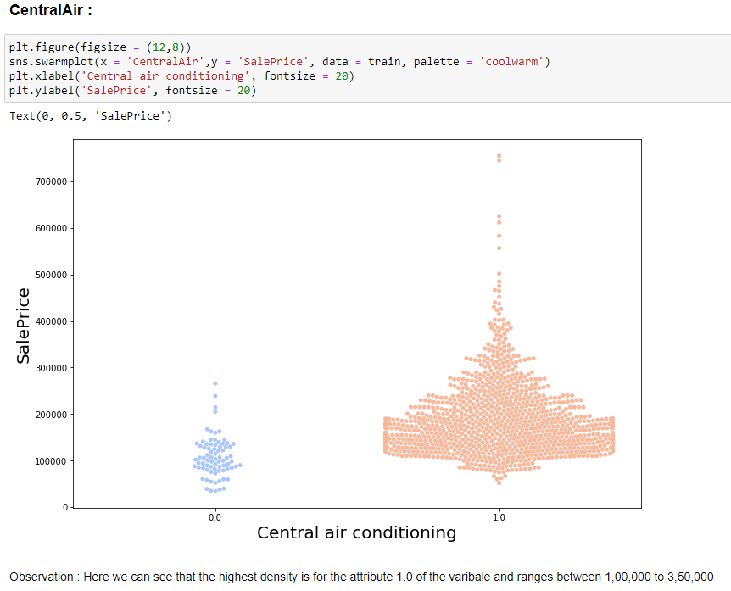
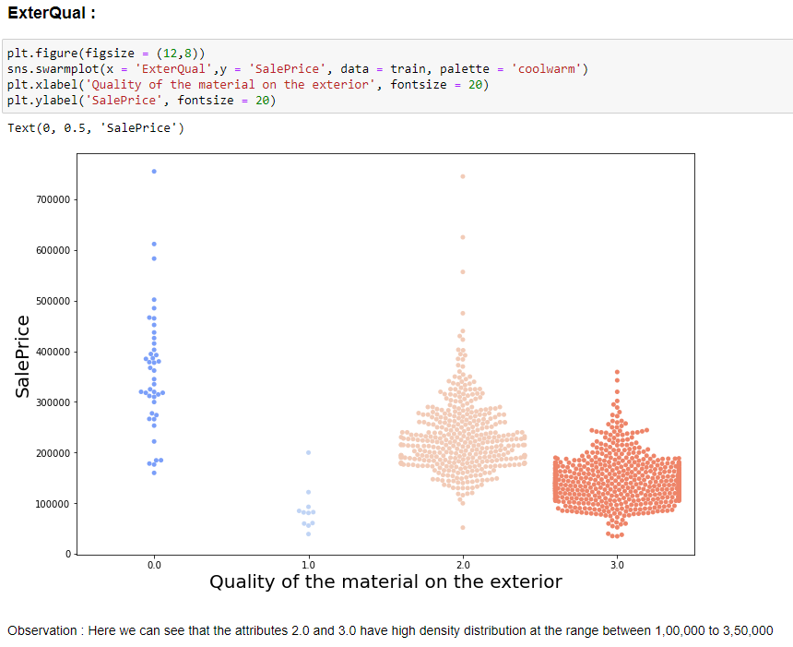

Slide 16
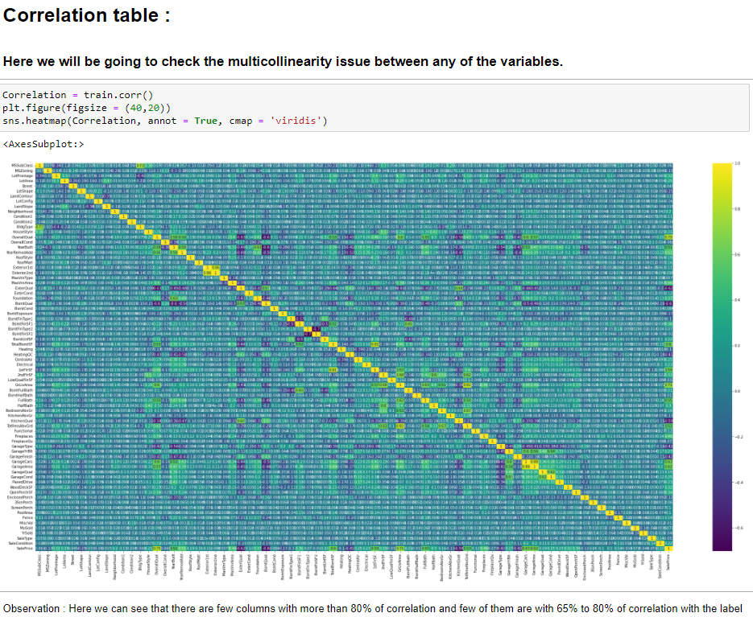

Slide 17
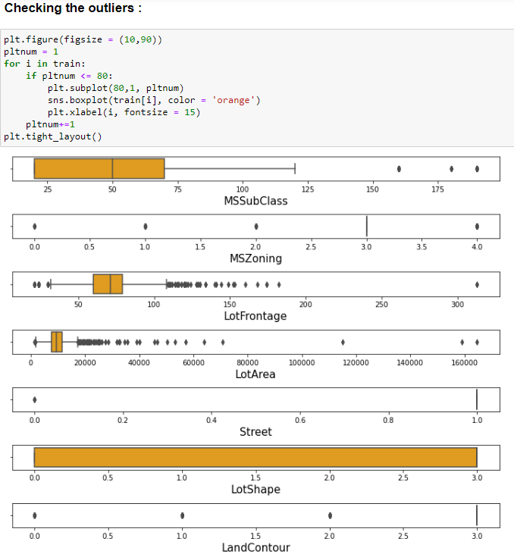
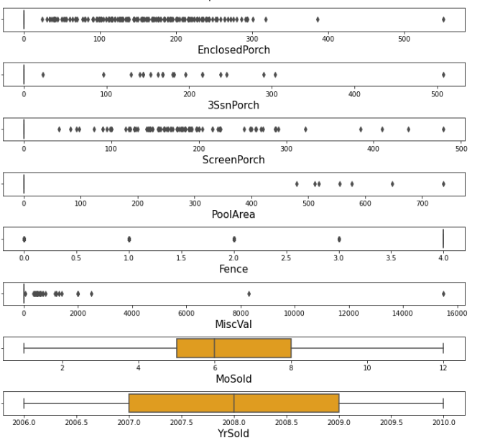

Slide 18
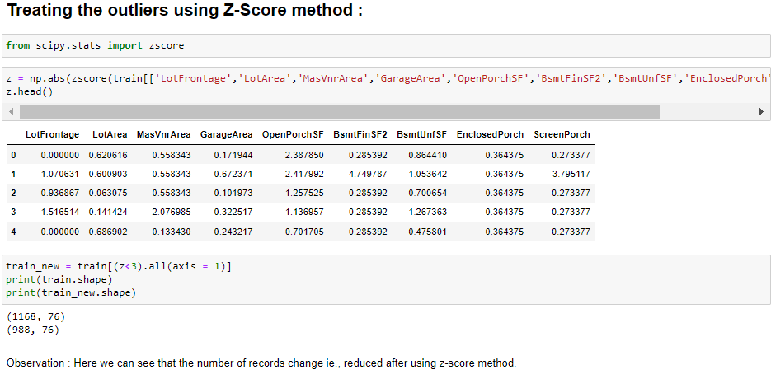
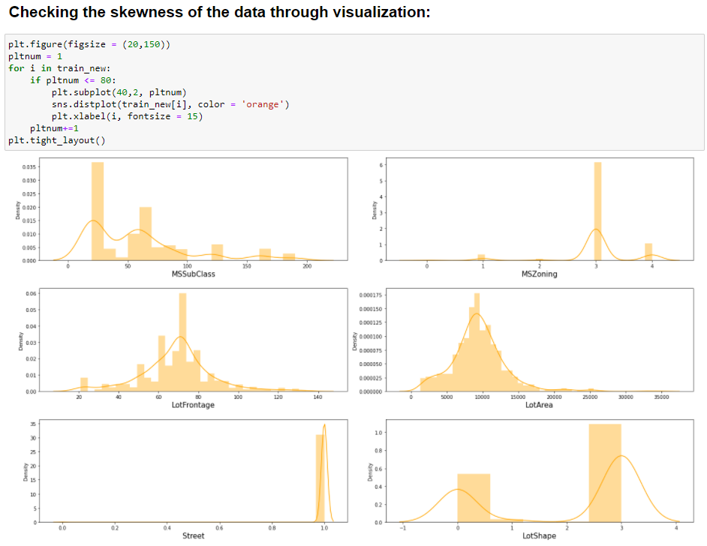

Slide 19
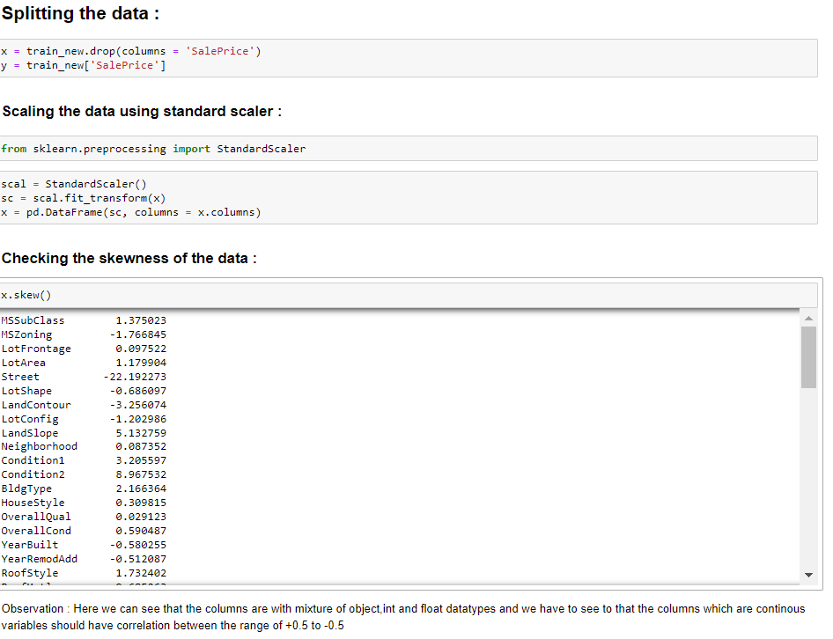
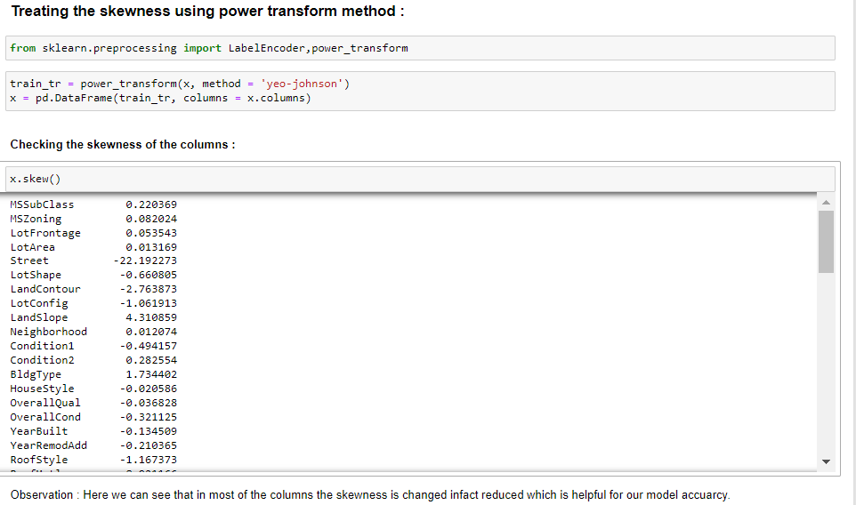

Slide 20
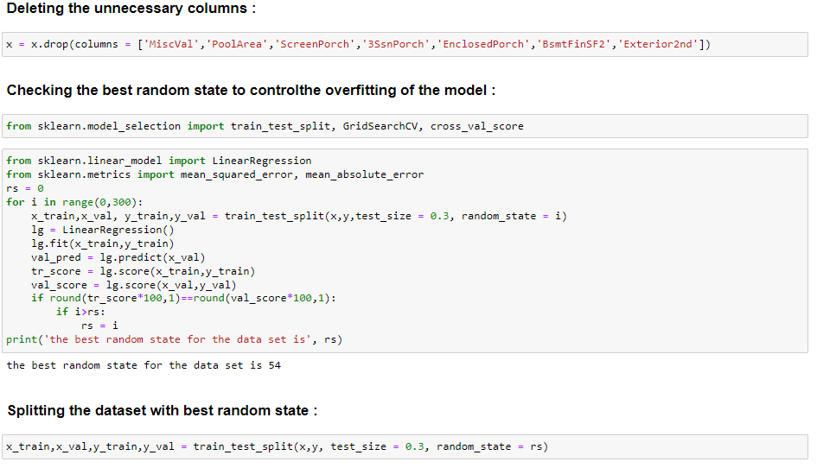

Slide 21
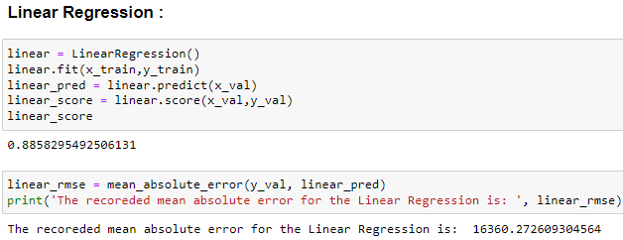
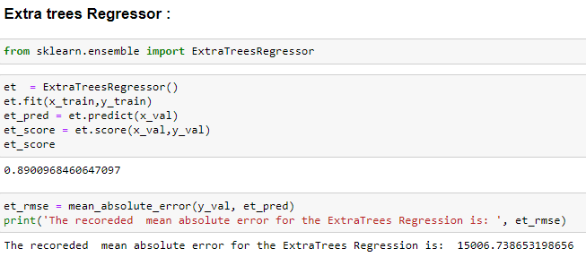
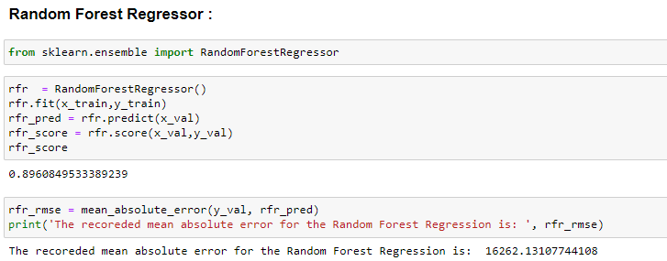
Using the Machine learning models:

Slide 22
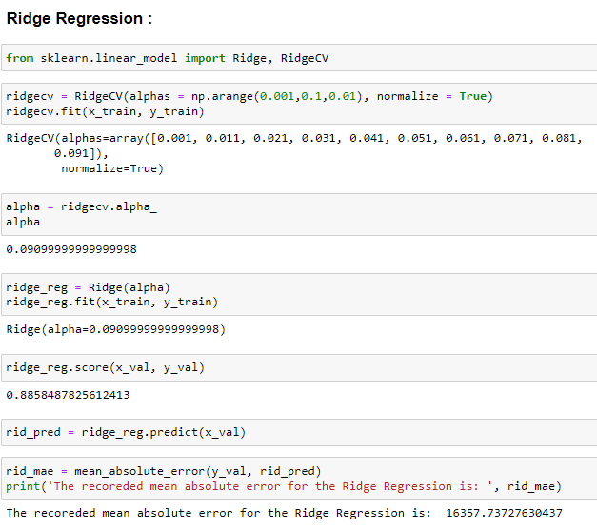
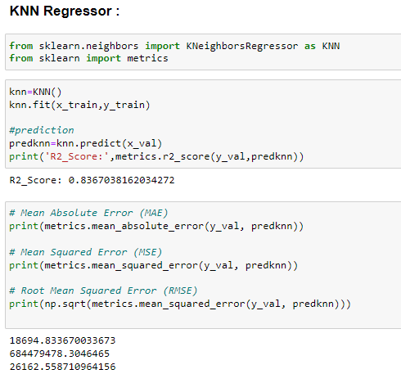

Slide 23
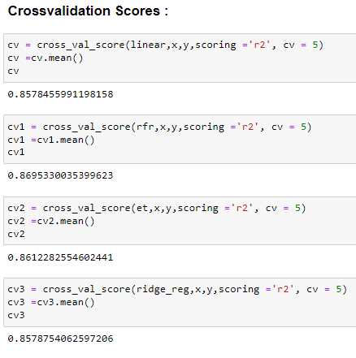
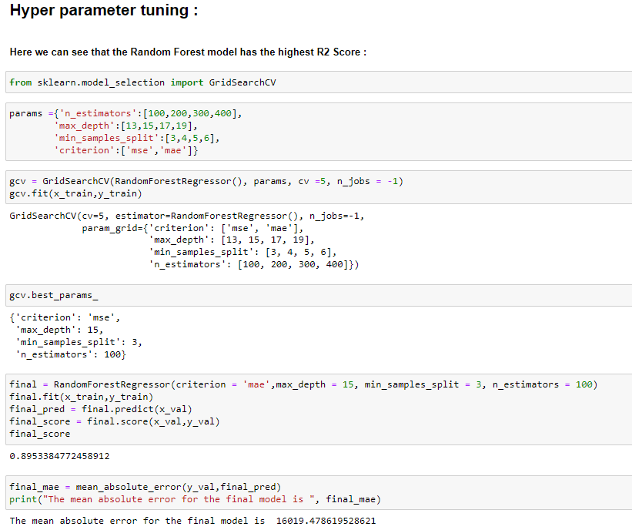

Slide 24
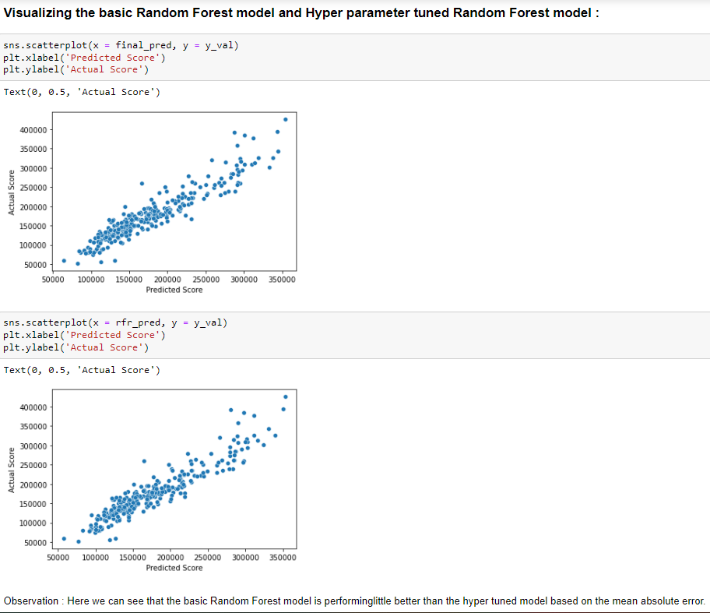

Slide 25
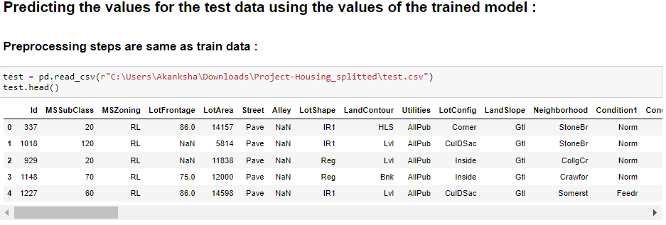
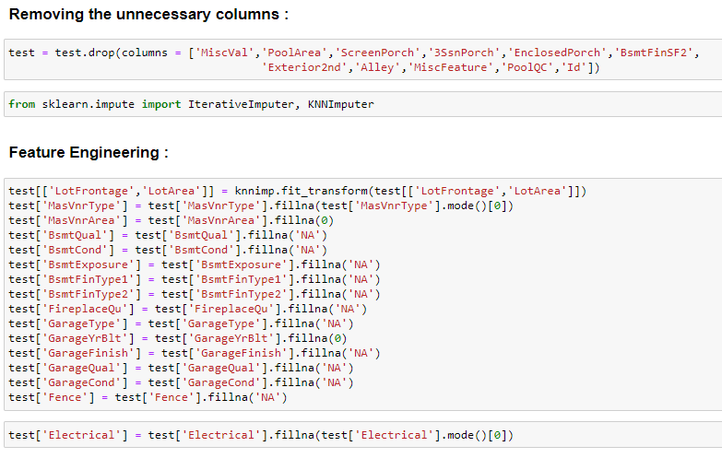

Slide 26
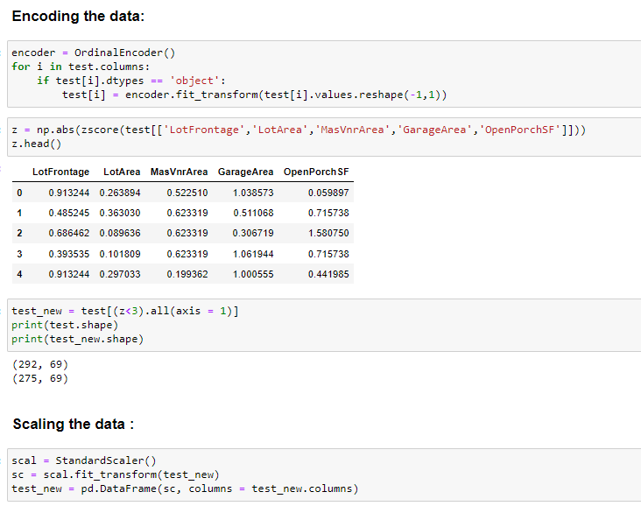
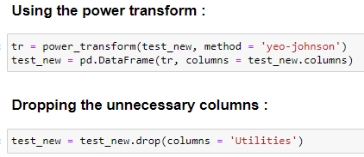

Slide 27
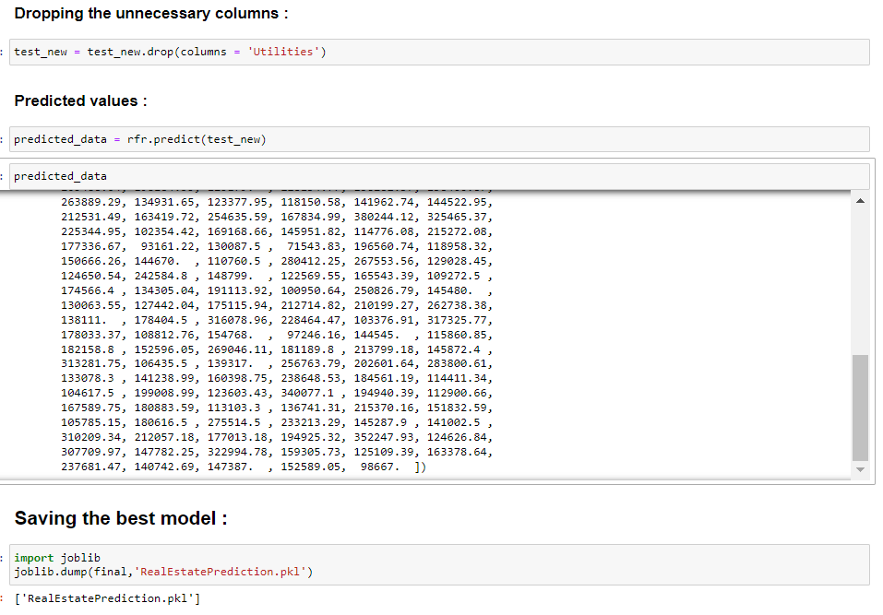

Slide 28
Conclusion:
• Key Findings and Conclusions of the Study:
So, our Aim is achieved as we have successfully ticked all our parameters as mentioned in our Aim Column. It is seen that circle rate is the most effective attribute in predicting the house price and that the Random Forest Regressor is the most effective model for our Dataset with accuracy score 89.5%.

Slide 29
Limitations of this work and Scope for Future work:
The request contains a list of features, that matches the public dataset's features, that is desired to be available when the data is sent.
There is no guarantee that the data will be available in time nor contains the exact requested list of features. Thus, there might be a risk that the access will be denied or delayed. If so, the study will be accomplished based only on the public dataset.
Moreover, this study will not cover all regression algorithms; instead, it is focused on the chosen algorithm, starting from the basic regression techniques to the advanced ones.

Slide 30


